Slide 1

TITLE
Predictive Analysis of Customer Booking Behavior
Predictive Analysis of Customer Booking Behavior
Thandokazi Dlamini

Slide 2
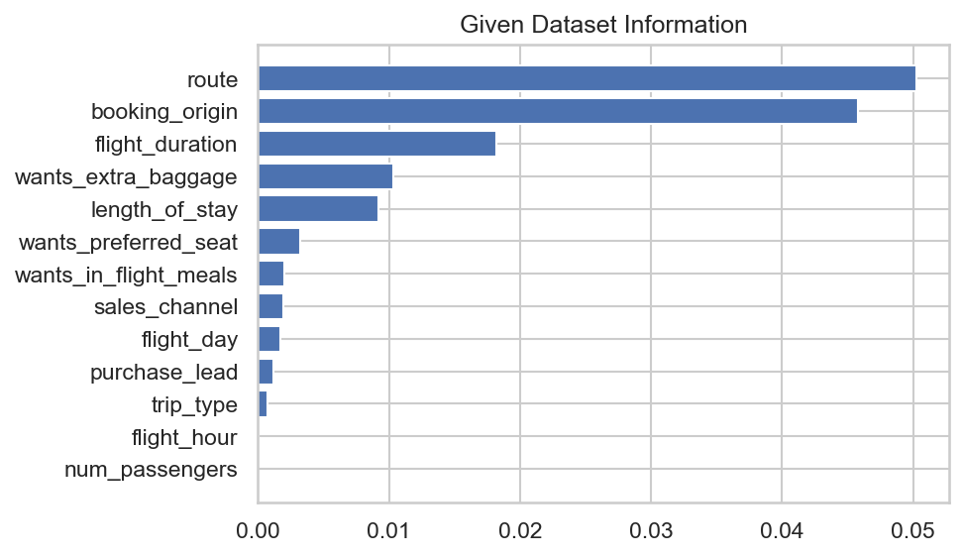
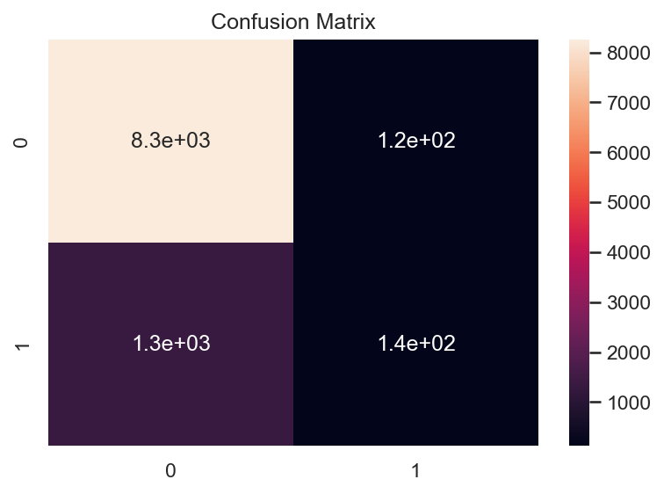
Predictive Analysis of Customer Booking Behavior
Insights:
Key Influencers: Route, Booking Origin, Flight Duration, Extra Baggage, Length of Stay.
Model Performance:
Method: XGBoost Classifier
Accuracy: ~85%
Confusion Matrix: Strong in identifying non-completions, needs improvement in predicting actual bookings.

